Slide 1

Cornelius Vermuyden
“Year 11 Raising Achievement”
2016-17
Deputy Headteacher - Ian Hockey

Slide 2
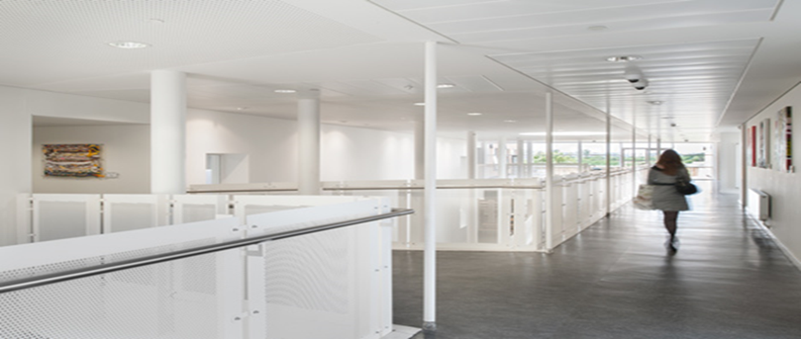
What is tonight all about?
Importance of Parental Involvement
Understanding the term ‘success’
New 9-1 Assessment
Base Camp – Where are we now?
Rhythm of the Year – Key Dates
Revision Matters (How to revise effectively)
Core Subject Information

Slide 3
The Key Message
GCSE attainment is positively influenced by the level of parental engagement : The more parents get involved, the higher the level of attainment.
Parents have the greatest influence on the achievement of pupils through supporting their learning in the home rather than supporting activities in the school. It is your support of learning within the home environment that makes the maximum difference to achievement.
(DfE, 2013)

Slide 4
What can parents do to support from home?
Reinforce a positive and resilient ‘can do’ attitude.
Support excellent attendance to lessons and extra sessions.
Engage with your child about their work and academic reports.
Monitor organisation of learning equipment, revision material/timetable, deadlines and homework.
Create an appropriate independent study area at home or support attendance to the school’s study area.

Slide 5


“The Holy Trinity”
“SUCCESS”

Slide 6
Guess the number…..
36
33
825
….. Days until the Mock examinations begin
……Weeks until the first examination
…… Lessons left until examinations start
Notes:
16 days until your first mock exam
28 weeks until your first actual GCSE exam (English)
43 weeks until you collect your GCSE Exam Results
10’450 Hours of learning before undertaking exams
20 hours on average exam time…..

Slide 7
What makes success?
“Individual journey”
Practice makes permanent
Engagement for Learning
Commitment to learning
Exam
Success
Regular Attendance
Seek and accept help and support

Slide 8
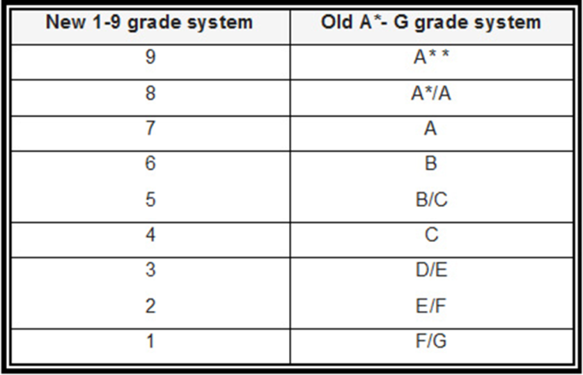
A New Landscape.…..
Good bye A*-G
Hello 9-1
Much less coursework
All exams at end of Year 11
1 | 2 | 3 | 4 | 5 | 6 | 7 | 8 | 9
F/G | E/F | D/E | C- | C+/B- | B | A | A* | A**

Slide 9
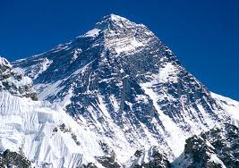
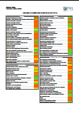

Where are we now?
What will it take to reach the summit?
What got you here (base camp) might not get you to the summit
Maths – RAG rated performance at topic level
English – RAG rated performance at question level
Notes:
You have been successful so far on your school journey, but GCSEs are now a new step forward, a transition into working smartly, hitting tighter deadlines, examined units.
This requires students to think differently – use the Everest/summit approach – what gets you to ‘basecamp’ does not get you to the summit.

Slide 10
Summit
Personalised Timetables
Half Term School –May
Easter School – 03/04 -13/04
March PPE’s (Blind Mocks)
22/03 – Data Collection 4
Half Term School 13/02 – 17/02
08/02 – Data Collection 3
Wave 2 Intervention 13/01
Early January 2017 – PPE Results Day
14/12 – Data Collection 2
Parents Evening 08/12
Starting 28th November PPE’s (Blind Mocks)
Wave 2 Intervention 07/11
Half Term School – 22/10 – 29/10
01/11 – Mentoring Programme Begins
“Revision Cracked” Seminar 04/10
19/10 – Data Collection 1
RAG Rated Performance
“FIX UP” Motivation Speaker Tomorrow P5
Base Camp
HT Personalised Intervention Timetables

Slide 11
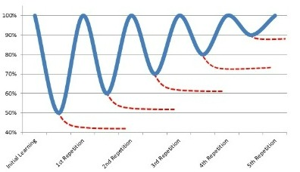

Revision Techniques
How do I revise???
“Revision Cracked” External Workshop 04/10 – Share with you techniques to utilise in preparation for the PPE’s (Mock Exams)

Slide 12
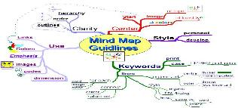
Revision Techniques
45 Different revision techniques (Are there 4/5 that work for you?)
Different revision techniques work for different people. The student must find the strategies that work best for them. Simply reading over their notes is not revising. They need to do something with the information.
Prompt cards
Mind maps
Post it notes
Summary tables & grids
Teach someone else
Memory games

Slide 13
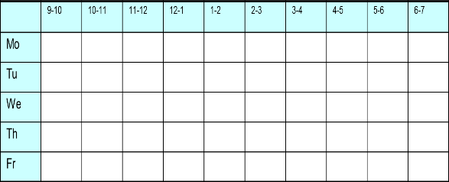
Revision Timetables: Working Smartly
It is WHAT you revise not the QUANTITY that delivers success.
A revision timetable will help your son or daughter plan their time and achieve the most - avoid last minute panics and cramming.
Be honest & realistic – do they work best in the mornings, afternoons or evenings?
Plan in breaks for regular hobbies.
Incentivise & reward.
Keep each session between 45 – 60 minutes max
Notes:
Revision schedules are important to establish from the start of the course- many coursework pressures are light currently, students feel they have time, but establishing a habit takes 28 days – by October half term, the habit of regularly revisiting core learning (in addition to home learning) could be embedded and part of a students routine. When the pressure mounts, this habit is less lilkely to fall by the wayside and students begin to work smartly, managing the pressure and their time more effectively, and therefore ensuring better emotional wellbeing.
When planning a revision schedule it is important to think about the rest breaks – ensure the brain has chance to rest and relax – think of an active activity, sport related, to release endorphins!
It is what you revise, not how much revision, or the length of revision that has the impact – Use the PLC information and the gap analysis information to target specific revision around key areas of focus.

Slide 14








Marginal Gains
What will make the difference for you?
Sir David Brailsford, Performance Director of British Cycling in the run-up to the 2012 Olympics, developed the concept of ‘marginal gains’.
To improve an athlete’s performance, the athlete simply has to make a 1% improvement, but in a number of areas. When these marginal improvements combine, they compound to have a real effect on overall performance.
Taking this principle, and applying it to a student’s approach to their GCSEs, there are marginal gains that can be made in many areas. An individual marginal gain has no impact, but when stacked together, they can make a real difference to a student’s grades.

Slide 15
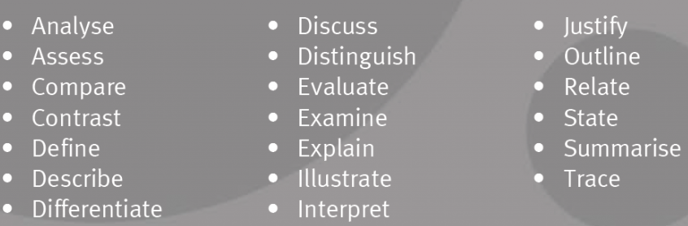
Know Command Words
It is essential that students understand the command words.
Otherwise they will trip up before they can show their subject knowledge.
Notes:
.

Slide 16

Music
Dr Nick Perham, University of Wales, Cardiff - research in 2010
Music impairs the ability to memorise information.
Music without lyrics is better than with lyrics.
Background television has the same effect.
Revise in a quiet place.
Notes:
.

Slide 17

Note-taking
Pam Mueller – Princeton University Research 2014
The pen is mightier than the keyboard for note taking.
Students who used laptops performed worst in test than those who made handwritten notes.
Notes:
.

Slide 18
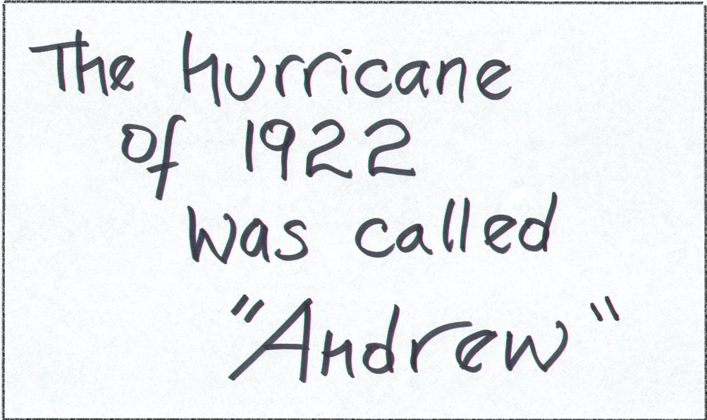
Repetition is the key to learning
Just writing the cards will help your recall. You can then test yourself
Use flash cards
Notes:
.

Slide 19

Repetition is the key to learning
Stick mind maps all around the house.
Notes:
.

Slide 20

Time Management
The largest pressure at GCSE level study are deadlines and time to revisit core learning.
“An extra hour a day of television, internet or computer game time in Year 11 is linked to poorer grades at GCSE, a Cambridge University study suggests”
BBC News 4th September 2015
Notes:
Time is going to be the largest pressure on students over the next two years of their education. They will face tight deadlines, managing exam pressures and the learning demand of GCSE courses is high – most courses have enough time to deliver content, little have time to revisit core learning.
BBC Study – link was that students equated to a 2 grade drop in one subject. This could be the difference between exceeding and not meeting a target grade.
Whilst rest and balance is highly important in maintaining emotional well being through a busy school diet, careful consideration needs to be given to ensure a balanced approach is encouraged from the outset.

Slide 21
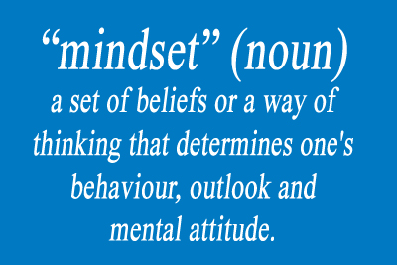
Mindset Matters
Positive

Slide 22


Revision + Mindset = Success?
“Reach for the top of the tree and you may get to the first branch but reach for the stars and you’ll get to the top of the tree.” (Lemn Sissay, MBE)

Slide 23
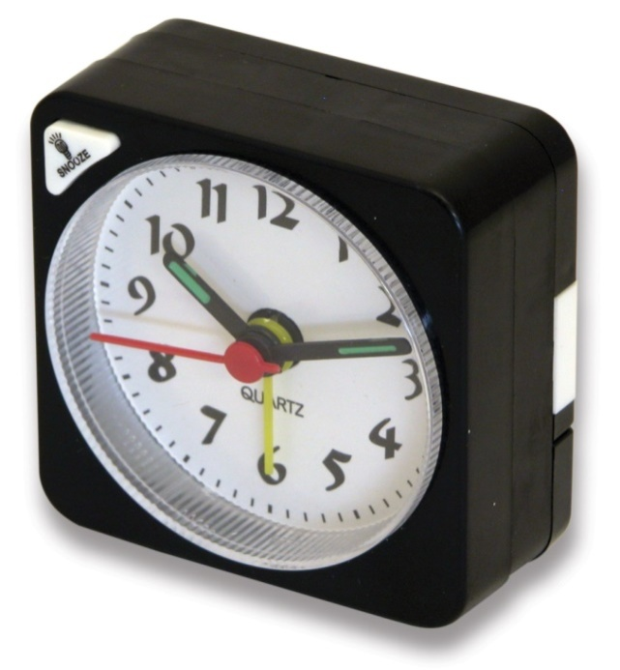
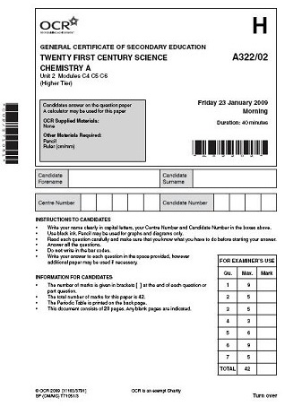
Repetition is the key to learning
Download pasted papers from the exam boards web site
Time your self on past papers.
Do as many as you can and check them against the mark scheme.
Notes:
.

Slide 24

Remembering dates
Battle of Trafalgar 1805
A series of numbers means nothing and will blur together in your mind unless you can find a way to attach significance to them.

Slide 25

Marginal Gains
Using social networking sites while studying lowers grades.
Notes:
.

Slide 26
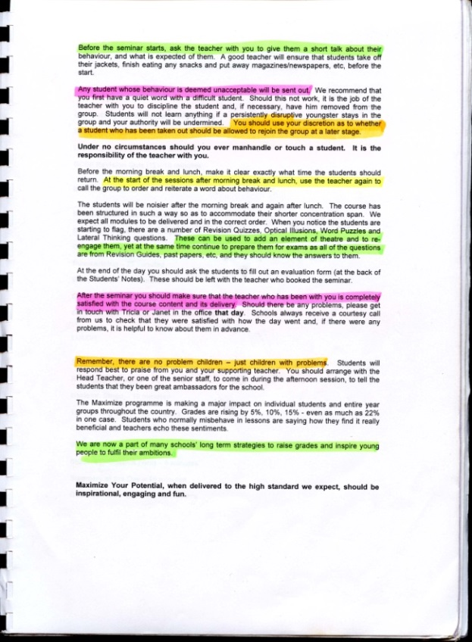

Marginal Gains
Develop a colour-coding scheme using highlighters
- key points in one colour, secondary points in another, etc.
This is a way of identifying key points later.

Slide 27

Marginal Gains
Use revision web sites.
Test yourself on past papers available on line.
Look at the learner guides and video clips on BBC Bitesize.
Notes:
.

Slide 28
Marginal Gains
Health, diet and sleep
Attend every lesson
Sit at the front
Take detailed notes
Presentation matters
Hit deadlines
Use a planner
Questions and feedback
Use your study periods
Positive attitude

Slide 29
English
Mrs Peel

Slide 30
Key Dates
W/b 31st October: Macbeth and An Inspector Calls Mock examination
23rd November: An Inspector Calls theatre trip
24th February : Poetry Live trip

Slide 31
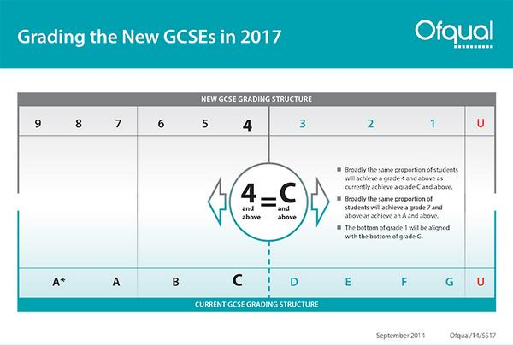

Slide 32
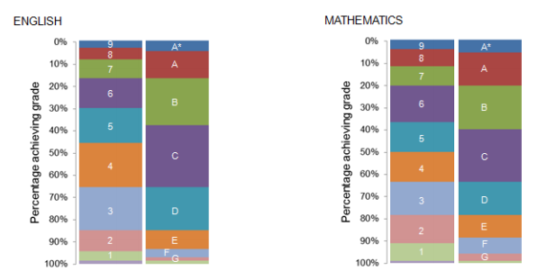

Slide 33


English
Students prepare for two qualifications:
GCSE English Language
GCSE English Literature
Both are new specifications for first teaching from 2015 assessed entirely by terminal exams in the summer of 2017.
No early entry.

Slide 34

GCSE English Literature
Exam Board Edexcel
No tier of entry
Every student sits the same exam
New grading system 9-1

Slide 35

GCSE English Literature
Examination texts have been studied during Year 10 ( A Christmas Carol, Poetry, An Inspector Calls) and 11( Shakespeare’s Macbeth) working towards two written exams in the summer of 2017

Slide 36

English Literature exams
Paper 1:
Shakespeare and Post-1914 Literature
1 hour 45 minutes, closed text (worth 50%)
  Section A: Shakespeare: Part A on an extract,
  Part B linking to the whole text (Macbeth)
  (worth 25%).
  Section B: Post-1914 Literature: choose one question out of two; on setting, character or theme (An Inspector Calls) (worth 25%).

Slide 37
English Literature exams
Paper 2:
19th Century Novel and Poetry since 1789
2 hours 15 minutes, closed text (50%)
  Section A: 19 Century novel, Part A on an extract,
  Part B on the full text (A Christmas Carol) (worth 25%).
  Section B: Poetry since 1789: one named poem from
  a cluster in the anthology (Relationships) that will be printed – students compare it to another (unprinted) of their choice. Students also compare two thematically linked unseen contemporary poems (worth 25%).

Slide 38
GCSE English Language
Paper 1:
Fiction and Imaginative Writing
1 hour 45 minutes (worth 40%)
  Section A: Short / long questions on
  unseen 19th Century fiction (1 hour) (worth 15%).
  Section B: Two images provided as stimulus for Imaginative Writing (45 minutes) (worth 25%).

Slide 39
GCSE English Language
Paper 2:
Non-fiction, Literary Non-fiction and Transactional Writing - 2 hours (worth 60%).
  Section A: short answers on two non-fiction texts, followed by a longer response question which is a comparison of writers’ use of language
  (1 hour 15 minutes) (worth 35%)
  Section B: two options of writing tasks linked to themes of reading materials – letters, job applications, articles etc. (45 minutes) (worth 25%).

Slide 40
Spoken Language Endorsement
Pass
Merit
Distinction
Separate endorsement
Not part of English Language GCSE

Slide 41

Three Top Tips for English
Become familiar with the texts your son/daughter is studying and discuss them with them.
Specimen papers, mark schemes and other resources are available on the Edexcel website: http://qualifications.pearson.com/en/qualifications/edexcel-gcses.html
Encourage your son/daughter to read and discuss non-fiction texts e.g. newspapers, leaflets, letters and magazines. The internet is awash with older 19th Century fiction and non-fiction texts because most are out of copyright.

Slide 42
Revision Guides
English Literature – Macbeth guide to buy
An Inspector Calls guide to buy.
A Christmas Carol and Poetry revision guides coming soon.
English Language and Literature workbook also available to buy.
£4 each or all three for £10.

Slide 43

PiXLit

Slide 44
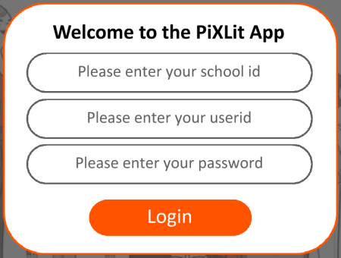
PiXLit
Download the ‘PiXLit’ app
Login using the following details
School id: CV3193 User name: Surname & first initial
Password: Surname & first initial
Log in to the PiXLit
Click on ‘Design a test’, ‘Please select a book’, ‘Macbeth’, ‘Character learning’, ‘Act 1’, ‘Begin Test’ and then go for it and answer the question.
Click ‘Mark all’

Slide 45
PIXL CURVE FEEDBACK
Paper 1 C19th Fiction and Creative Writing
Q1: I mark quote retrieval
Q2: 2 mark comprehension question
Q3: 6 mark analysis of language and structure
Q4: 15 mark evaluation of writer’s technique
Q5: Creative Writing (40 marks0
24 marks for information, ideas and organisation
16 marks for vocabulary, sentence structure and punctuation.

Slide 46
Paper 2: Non- Fiction texts and Transactional Writing
TEXT 1
Q1: 2 mark comprehension question
Q2: 2 mark quote selection and language technique analysis
Q3: 15 ark analysis of language and structure
TEXT 2
Q4: 2 mark comprehension
Q5: I mark language example from text
Q6: 15 mark evaluation question
COMPARISON
Q7a): 6 mark comparison of similarities
Q7b) 14 mark comparison of ideas/ perspectives
Q8: Transactional Writing: 40 marks

Slide 47
Please contact your English teacher
if you need anything.
Best wishes from the English team.

Slide 48
Year 11
Core Subject Information Evening
Maths at Cornelius Vermuyden
Mr Iain Williams

Slide 49
Key points for tonight
New GCSE Curriculum
Progress and Contact
Homework
Exam preparation and revision resources
How parents can help

Slide 50
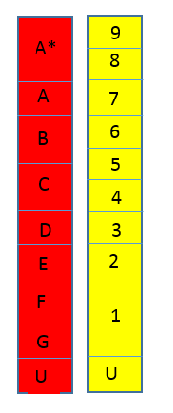
New maths GCSE grades for 2017
Top 3% of pupils achieve 9
7 is anchored to old A
5 is set between B and C
4 is anchored to old C
1 is the old F and G

Slide 51
New Maths GCSE for 2017
All students will study towards a GCSE in
Mathematics Higher or Foundation tier
Higher 9 8 7 6 5 4
Foundation 5 4 3 2 1

Slide 52
New Maths GCSE for 2017
Edexcel Linear 1MA1
100% examined (no coursework)
THREE written exams
Paper 1 Non calculator (80 marks) 1 ½ hours
Paper 2 Calculator (80 marks) 1 ½ hours
Paper 3 Calculator (80 marks) 1 ½ hours

Slide 53
New maths GCSE grades for 2017
Greater focus on problem-solving.
Requirement to provide clear mathematical arguments.
New added content at both Higher and Foundation level.
Fewer formulae provided. (students expected to remember them!)

Slide 54
Progress and contact
Progress monitored by teacher through half-termly assessments, class work and homework
Pre-Public Exams
Monthly mocks
All these will be used to ensure correct tier
Go4schools
Contacting your child’s teacher – email is preferable in the first instance

Slide 55
Homework
Set every week.
Designed to reinforce content learnt in lessons.
Sufficient time always given to enable students to ask teacher for help if needed.
Contact made with home if homework is not regularly completed.
Homework will be recorded on ‘Show My Homework’.

Slide 56
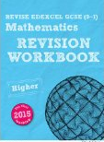
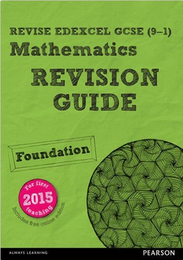


Exam preparation and resources
Revision guides and workbooks produced by Edexcel will be available to buy from school.
Scientific calculator
Practice, practice, practice makes perfect.
Work through exam papers.
Use GCSE booklets (available on Edexcel website) to work on ‘weak’ topics.
Attend revision sessions.

Slide 57
Further resources
www.mrbartonmaths.com
www.mathswatchvle.com
www.mymaths.co.uk
www.corbettmaths.com
www.methodmaths.com
www.mathsapp.pixl.org.uk

Slide 58
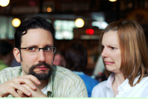
What can you do to help?
Be positive
‘I was never very good at Math's…’

Slide 59
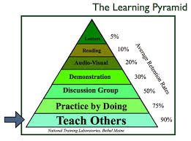
What can you do to help?
Act as a “Project Manager”
Know your child’s target grade
Be positive & supportive
Help them to organise themselves
Get your child to explain

Slide 60
Exam Dates
Paper 1 (non calculator) 25th May - AM
Paper 2 (calculator) 8th June - AM
Paper 3 (calculator) 13th June – AM
Summer ½ term between papers 1 and 2

Slide 61
Any further questions can be answered in B1.1 after this meeting

Slide 62
Science Information Evening

Slide 63
Double Science
Core Science A (4405)
Biology – 1 Hour Exam Paper – 25%
Chemistry – 1 Hour Exam Paper -25%
Physics – 1 Hour Exam Paper – 25%
ISA (Coursework) completed in school -25%

Slide 64
Double Science
Additional Science (4408)
Biology – 1 Hour Exam Paper – 25%
Chemistry – 1 Hour Exam Paper -25%
Physics – 1 Hour Exam Paper – 25%
ISA (Coursework) completed in school -25%

Slide 65
Key Dates
Core Science A (4405)
Biology 1 - 16th May pm
Chemistry 1 – 18th May am
Physics 1 – 24th May pm

Slide 66
Key Dates
Additional Science (4408)
Biology 2 - 9th June am
Chemistry 2 – 14th June am
Physics 2 – 16th June am
Unit 3 papers for Triple Science and straight after.

Slide 67
How to help
Attendance
Homework
Active Revision

Slide 68
Revision Techniques
Past Papers
http://www.aqa.org.uk/exams-administration/exams-guidance/find-past-papers-and-mark-schemes
Post it notes
Revision cards
Mind maps
Card sorts

